Slide 1
CPLN 671/MUSA 500: Statistical and Data Mining Methods for Urban Data Analysis Course Overview

Slide 2
Course Instructor
Eugene Brusilovskiy (he/him/his)
eugeneby@design.upenn.edu
267-939-0230 (Cell)
Office hours by appointment
TA:
Alex Nelms
nelms@design.upenn.edu

Slide 3
Introductions
Please introduce yourself to the class in 30 seconds
Please indicate:
Your name & what you go by
Program you are in (MUSA, Planning) & Year
Your educational/professional background and interests
Any experience with statistics, GIS, etc.
Any additional information you’d like to share (interests, likes, pronouns, etc.)
If you haven’t yet, please send me this info via e-mail
Helpful to get to know you, and for writing recommendation letters in the future

Slide 4

Course Description
Lectures twice a week: MW 5:15-6:45
Some lectures will be shorter than 1.5 hours. Some may run a little over.
Course history and evolution
Repetitio est mater studiorum
The option of taking ESE 502 in the spring, which is an excellent, though very challenging, course on spatial statistics that is sometimes offered
This course will cover a range of concepts typically covered in several courses
This will be a fast-paced course!
Nowhere as fast as the Bootcamp, though ☺
Some of the tools will have origins in statistics, others in data mining.

Slide 5
Class Logistics
Mask policy: I ask that you wear a mask to protect yourselves and others
Because COVID is unpredictable, we may need to have a backup class location on Zoom in accordance with any guidance which may be issued by the University.
Furthermore, if I am sick, then out of abundance of caution, I will hold class on Zoom rather than in person
Check your e-mail the morning of each class. If the class is going to be held via Zoom, I will generally let you know by noon the day of, and will send out a link.
Any classes held via Zoom will be recorded and recordings will be made available online
2-3 classes over the course of the semester will consist of pre-recorded material that students can find on Canvas
I am always available to answer any questions about that material

Slide 6
Topics Covered
The course will have 2 major parts:
Regression analysis for urban data
Classical regression approach: OLS regression
Regression methods for when OLS assumptions are violated:
Spatial lag, spatial error and geographically weighted regression
Logistic and multinomial logistic regression
Stepwise, lasso and ridge regression
Pattern finding in urban data
Global and local spatial autocorrelation
Spatial point pattern analysis (nearest neighbor analysis, k-functions)
K-means and hierarchical clustering
Working with Twitter Data: An Introduction to Text Mining
Introduction to Big Data Analytics

Slide 7
Regression Analysis
What variables can predict the levels of burglary in Philadelphia, at the block group level?
House Values (HV)
Income (I)
Education of Householder (EH)
You can use regression analysis with burglary as the dependent variable and HV, I and EH as independent (or predictor) variables.

Slide 8
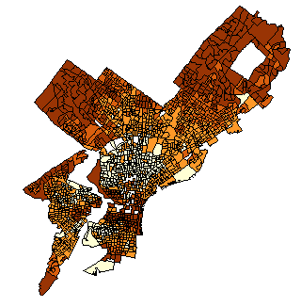
Spatial Autocorrelation
Do block groups with similar house values seem to cluster? That is, are block groups with high median house values near other block groups with high median house values?
Census Block Group Map of Philadelphia Median House Values, 2000

Slide 9
Incorporating Spatial Autocorrelation into Regression
Turns out that regression analysis requires that observations be independent of one another
That is, values of variables at one observation don’t affect values of variables at another observation
This isn’t the case in most spatial problems
Nearby block groups have similar values of variables
We will use various forms of spatial regression to account for these spatial dependencies in the data

Slide 10
Can Model Select Significant Variables?
There’s a way for the model to automatically select and include only those variables which are statistically significant
This is called Stepwise Regression

Slide 11
More Predictors than Observations
Turns out that traditional regression methods fail when:
There are more predictors than observations
Predictor variables are strongly correlated with one another
We will use Ridge and LASSO regression to address these issues

Slide 12
Binary or Categorical Dependent Variables
The regression methods we discussed earlier assume that the dependent variable is continuous
What happens if the dependent variable is binary?
E.g., Presence/absence of park in county; L&I violation (yes/no)
Logistic Regression
What happens if the dependent variable is categorical?
E.g., Stand-alone (single)/duplex/multi-family building
Multinomial Logistic Regression

Slide 13
Study Design
Discussion of various study designs: correlational, causal (Randomized Controlled Trials), etc., and how they are implemented in City Planning

Slide 14
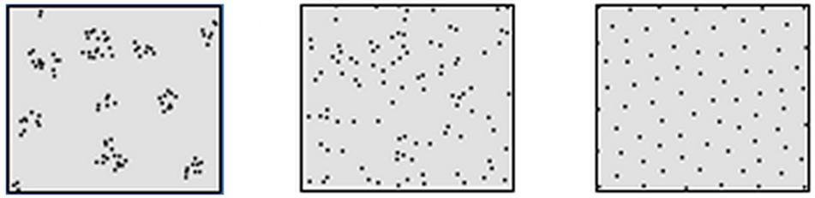
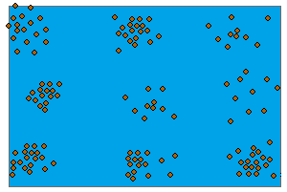
Point Patterns
Are these patterns of burglaries random, clustered, or dispersed?

Slide 15
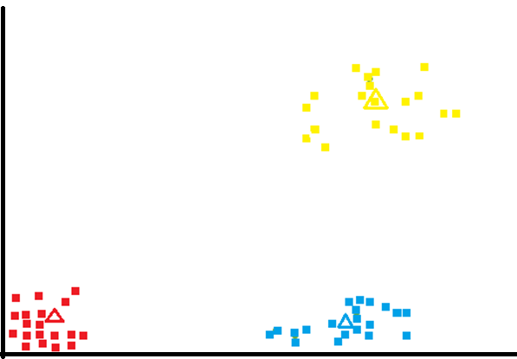
Cluster Analysis
Years of School
Income

Slide 16
Working with Live Data
Access Twitter for latest tweets
Mapping tweets
Looking at the content of tweets (basic text mining)
Example: what sorts of things are people saying on Twitter about #COVID19?
Where are these tweets coming from?

Slide 17
Approaches to Problem Solving
Discuss differences between statistics and data mining philosophies
Classical criticism of data mining approaches from statisticians:
Stats: theory/question driven vs. Data mining: data driven
Data mining is used because it makes fewer assumptions about data (variables, observations, etc)
Pattern/relationship discovery
Data exploration/pattern recognition
Criticism of “fishing”
“Black box” criticism
https://www.youtube.com/watch?v=jaI5aheBOi0
In reality, many contemporary data mining techniques are appropriate for solving a wide range of various theory-driven questions in situations where traditional statistical methods fail.
Each technique comes with its own assumptions,
Some algorithms are black boxes, others aren’t necessarily.
Dustbowl empiricism: “an approach to science and the social sciences that consists primarily of making empirical observations and collecting data rather than establishing a theoretical framework.” -- APA Dictionary of Psychology

Slide 18
Quick Review of Basic Probability and Statistics: Boot Camp!
Some Basic Math
Summary Statistics
Visual Representations of Data
What is Probability?
What is a Statistic?
Central Limit Theorem
Confidence Intervals
Hypothesis Testing
P-Values

Slide 19
Goals
My main goals with the course are to make sure that you:
Are comfortable with the various regression and pattern-finding methods covered in the course
Are able to interpret and write up results of various statistical tests
Understand the assumptions of different tests for spatial clustering and spatial autocorrelation and when to use them
Are familiar with R and several other software packages that are needed to run the different tests
There will be quite a bit of variability among students in terms of prior exposure to and experience with statistics.
This course will assume that you’ve had no exposure to statistics beyond the boot camp this summer.

Slide 20
Class Notes and Textbooks
Class Notes:
Power Points will be available on Canvas
They will be pretty comprehensive, however I strongly recommend that you take detailed notes in class
Textbooks:
There are no required textbooks for the course, but some might be useful as references. You won’t be assigned any readings or assignments from the books.
James, Witten, Hastie & Tibshirani: Introduction to Statistical Learning with Applications in R
Available for free at http://www-bcf.usc.edu/~gareth/ISL/ISLR%20First%20Printing.pdf
O’Sullivan & Unwin: Geographic Information Analysis, 2nd Edition
Available on Canvas
Jay Devore: Probability and Statistics for Engineering and the Sciences, 7th Edition
This book may be helpful for the lectures dealing with regression analysis
Any earlier edition is fine as well
Graham Williams: Hands-On Data Science with R: http://onepager.togaware.com/
Anselin, Luc. Exploring Spatial Data with GeoDa™: A Workbook. Available for free online at https://geodacenter.asu.edu/system/files/geodaworkbook.pdf, and on Canvas.
I will also be sending links to several manuals for the different software packages as we cover them, and several book chapters and articles that are relevant to the material that we cover.

Slide 21
Software
Available for Trial through PennDesign:
ArcGIS 10
Downloadable For Free:
R
Available for free from http://www.r-project.org/
Rtools
Available for free from https://cran.r-project.org/bin/windows/Rtools/
RStudio
Available for free from https://rstudio.com/
GeoDa
Download here: https://spatial.uchicago.edu/software

Slide 22
Assignments and Grading
I will issue 6 homework assignments, which are collectively worth 90% of your grade. These assignments are listed below. You are expected to complete 5 them: choose one of the two marked with an asterisk (*).
OLS Regression 20% of your grade
Spatial Lag, Spatial Error, and Geographically Weighted Regression 25% of your grade
Logistic and Multinomial Logistic Regression 20% of your grade
Point Pattern Analysis 15% of your grade
*K-Means Clustering 10% of your grade
*Text Mining Assignment 10% of your grade
You should work on the assignments with TWO other classmates and hand in a joint submission for all of these assignments. You will all receive the same grade on the assignment.
The remaining 10% of your grade will be class participation. You are strongly encouraged to attend the course (even for lectures which you think will be a review) and ask questions.

Slide 23
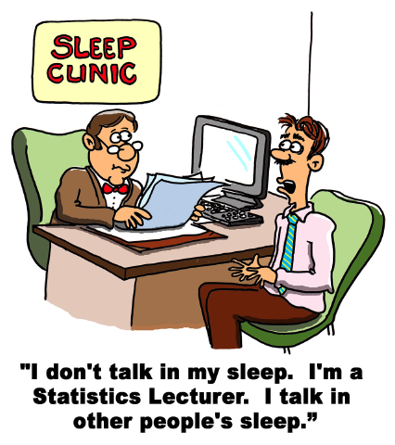


Class Participation
Source: www.causeweb.org

Slide 24
Grading
Late assignments
Please e-mail me if your submission is going to be late so that an extension may be granted.
In general, I always accept late assignments
Unsatisfactory reports and resubmissions
If you receive a grade below 80 on an assignment, you may redo it and resubmit it, applying and following the comments and suggestions that I give you.
The maximum grade you can get on the resubmission is 85.
The grades for the course will be distributed approximately as follows:
Approximately 50% of the students will receive grades in the ‘A’ range (A+, A, A-), 40% will receive grades in the ‘B’ range (B+, B, B-), and less than 10% will receive grades below a B-.

Slide 25
A Bit More About ESE 502
An excellent course that covers the spatial statistical methods in a very rigorous manner
Taught by Dr. Tony Smith, a leading expert on spatial statistics
You will learn the math behind many of the methods we will cover in this course, and will gain extensive experience on writing comprehensive statistical reports
A very challenging and rewarding course that you should consider as an elective for next semester

